Slide 1
The electronic structure of GdN from x-ray spectroscopy
Andrew Preston
andrew@preston.co.nz
Department of Physics
Boston University

Slide 2
NML at BU
Kevin Smith
Louis Piper
Sang Wan Cho
Alex DeMasi

Slide 3
Co-authors
Ben Ruck, Joe Trodahl
Victoria University of Wellington, New Zealand
Walter Lambrecht
Case Western Reserve
James Downes
Macquari University, Australia
Louis Piper, Kevin Smith
Boston University

Slide 4
Overview
High quality thin films
Temperature dependant
X-ray at the N K- and Gd M-edges
Absorption
Emission
Resonant emission

Slide 5
GdN
Half-filled 4f shell
Phys. Rev. B 73, 235335 (2006)
Semiconducting
Ferromagnetic 70 K
Phys. Rev. B 76, 085211 (2007)
Optical redshift
J. Appl. Phys. 106, 063910 (2009)
Epitaxial GdN
n ~ 4 x 10²⁰ cm⁻³
Negative magnetoresistance
YSZ capping layer

Slide 6
X-ray absorption (XAS)
Empty
E_{f}
Filled

Slide 7
X-ray absorption (XAS)
Empty
E_{f}
Filled

Slide 8
X-ray emission (XES)
Empty
E_{f}
Filled

Slide 9
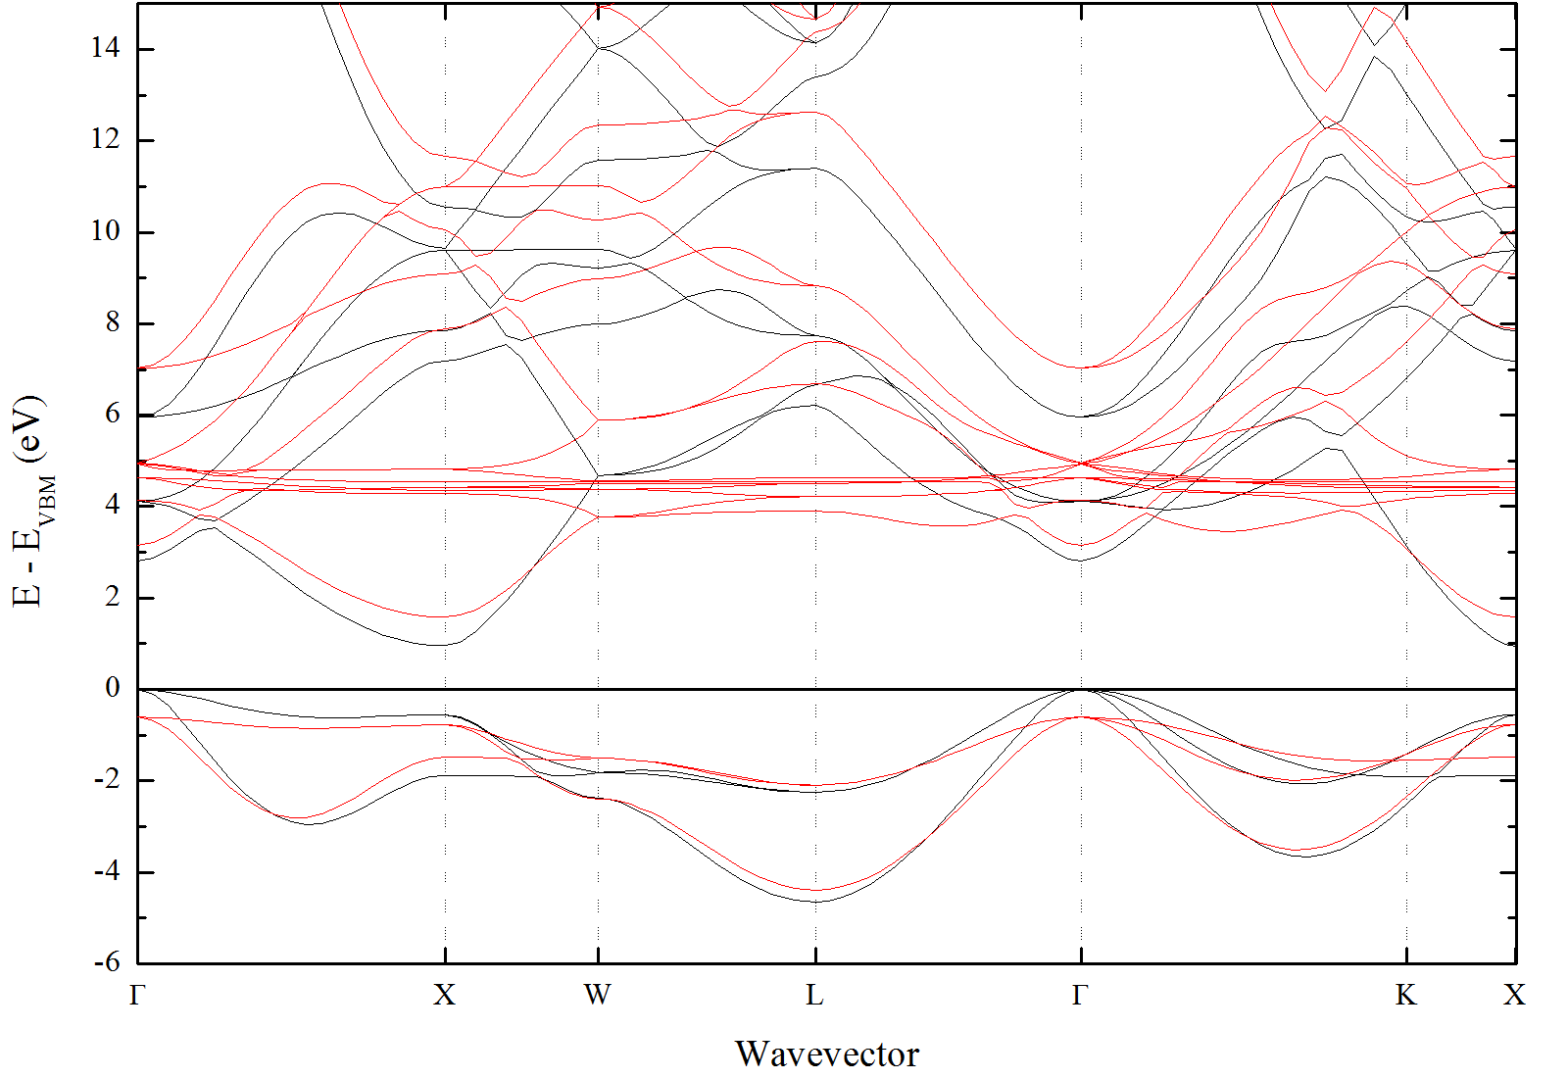
Band structure
Notes:
Gd 4f bands at 5 eV
VB is made up of N p bands
CB is made up of Gd 5d and 6s bands
Optical gap at X

Slide 10
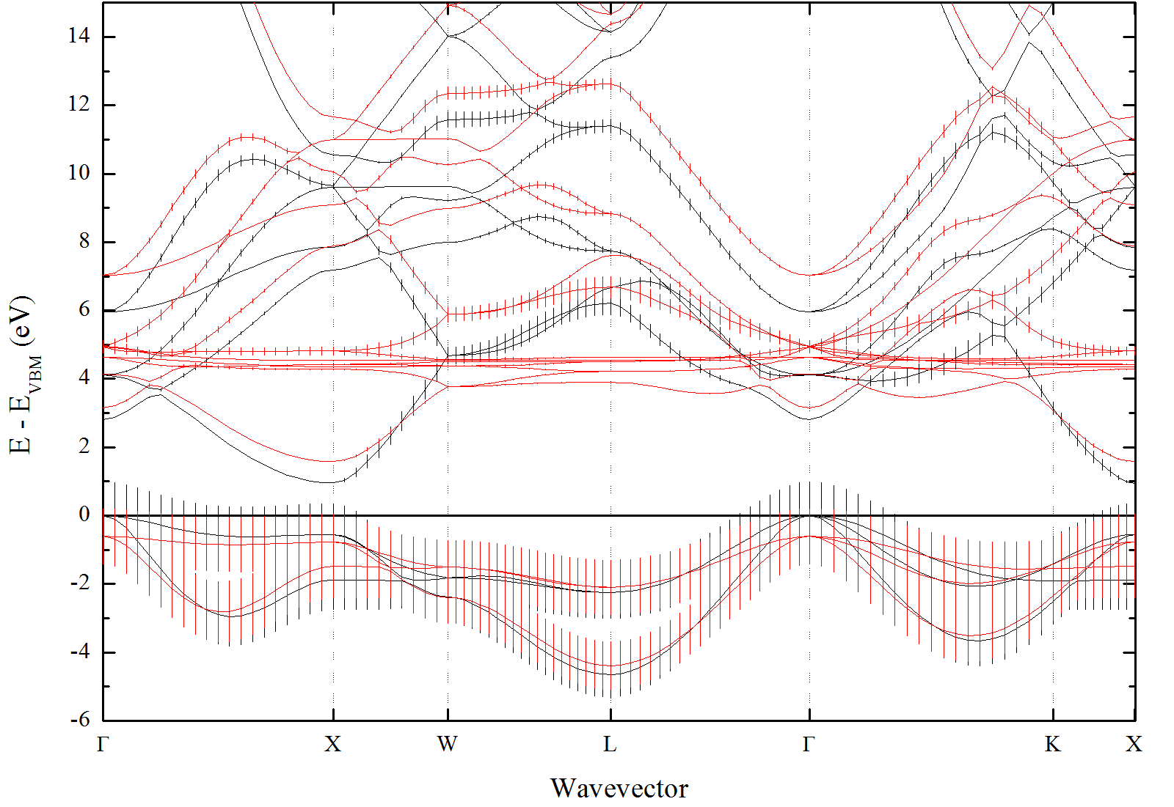
Band structure
Notes:
N p-projected character. Very little hybridization with 4f bands.
At CBM there is no N p-character between G-X, but along X-K and X-W.

Slide 11
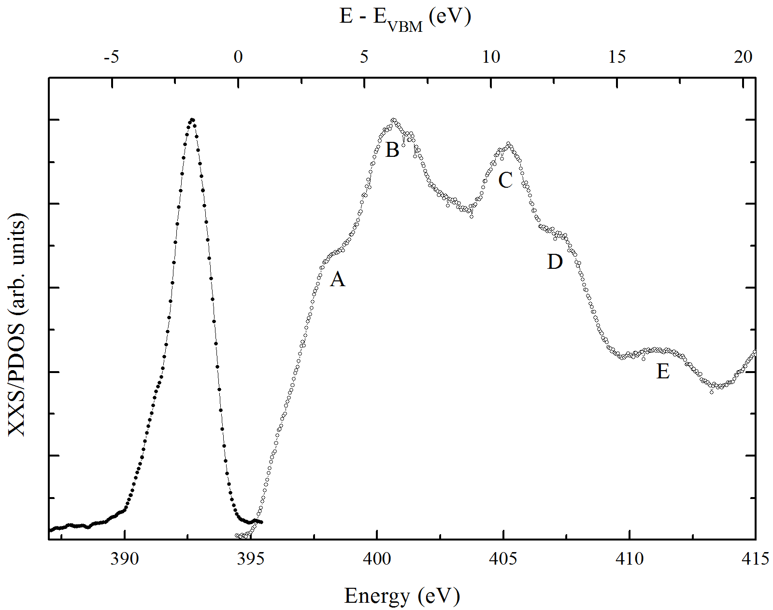
N K-edge XXS
Notes:
Occupied and unoccupied states.
XES is from N p-like valence band states. Shoulder is from states between G-X, G-K and at L.
XAS is the N p-like character of the unoccupied Gd 5d and 6s states.
Two main peaks are the Gd 5d crystalfield split t2g (N pi) and eg (N sigma) anti-bonding states.

Slide 12
ReN N K-edge XAS
Notes:
Across series peak B is stationary, peak C shifts to higher energy. Attributed to differences in N pi/sigma bond with Re 5d crystal field split states.

Slide 13
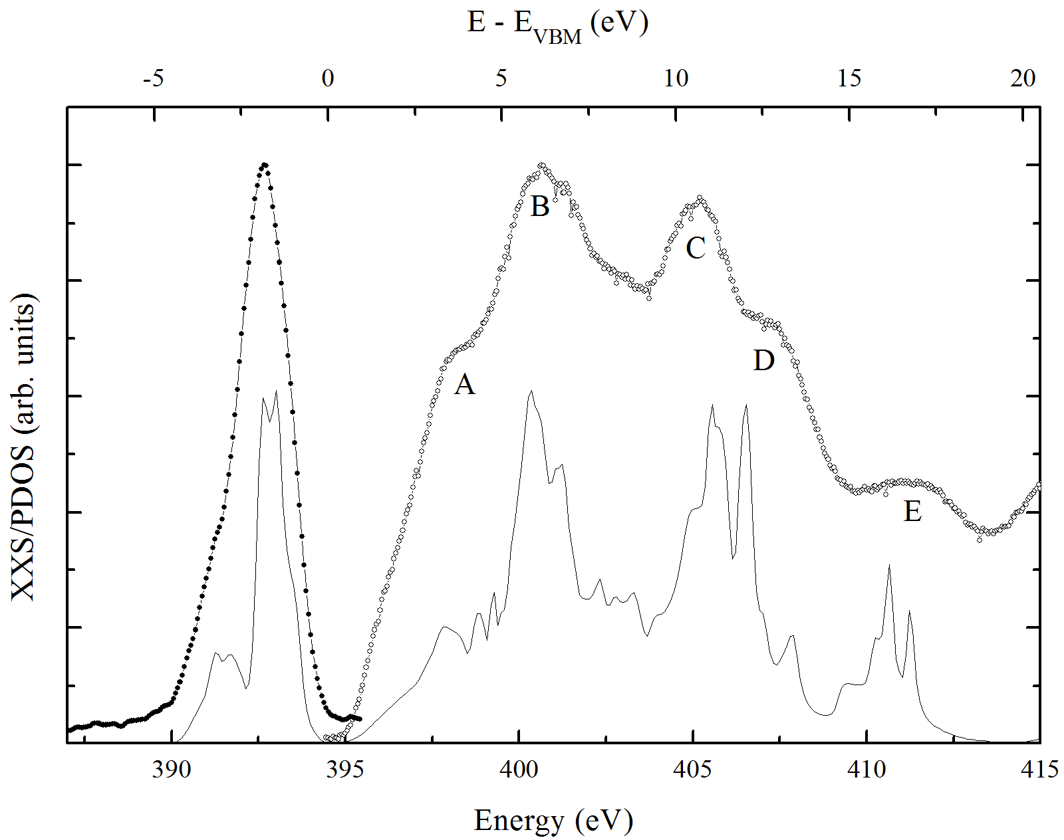
N K-edge XXS
Notes:
Excellent agreement between experiment and theory. Aligned by main XES peak (no shift between XAS and XES).
B and C explained by Gd 5d states.
Where does double peak structure and peak A come from?

Slide 14
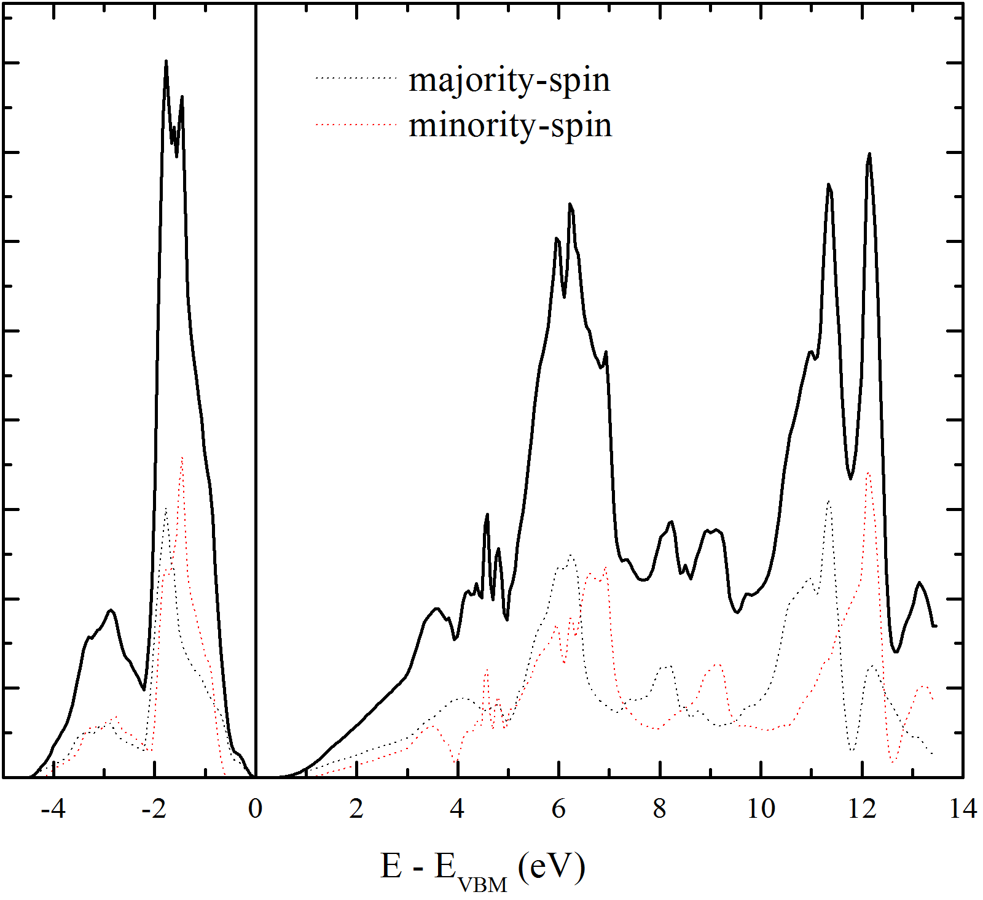
Spin-resolved PDOS
Notes:
All due to spin-split nature of band structure

Slide 15
M-edge XAS and XES
Notes:
XAS: fairly typical atomic multiplet spectrum. Gd 3+ calculation.
XES: low resolution, note 5p peak.
4f final states of 4f8 and 4f6 for XAS and XES are same as XPS/BIS final states.
Estimate the 4f splitting as published for XPS/BIS – get 12.5 eV, roughly the same result

Slide 16
Thanks
Appl. Phys. Lett. submitted

